Slide 1
C程式設計實驗(二)
Chapter10. Pointer

Slide 2
Pointers Variables
Pointer definition :
A pointer is a variable that stores the memory address of an object
A pointer is a type of variable
Can store pointer in variable.
Operators：
“&” addressof operator
“*” dereferencing operator
Notes:
指標 pointer是用來儲存變數的記憶體位置，它也是屬於一種變數型態。
透過指標變數就可以直接存取該指標變數所指定的位置。

Slide 3
Declaring Pointers Variables
Declare : type *ptr
int *p, float *n, double *s, char *c
Initialize
int *p = NULL; // it can be assigned a value of null or 0
int i = 5;
p = &i; // assign pointer to address of object
int j = *p
illegal instruction
int *p=10;
Notes:
宣告指標變數使用星號運算子來表示 type 為該位址儲存值的型態，則ptr 可儲存變數的位址
初始化指標的方式為分配一個nullptr值或是0，這邊的0並不代表數值
另外我們也可以分配一個非指標變量的位置，像是先宣告int i=5，接著會使用到&的符號變數i的位置指定給p，這樣p 所儲存的值就會和&i取出的值相同
在一開始宣告指標的時候是不能直接提供數值給他，這是不合法的!

Slide 4
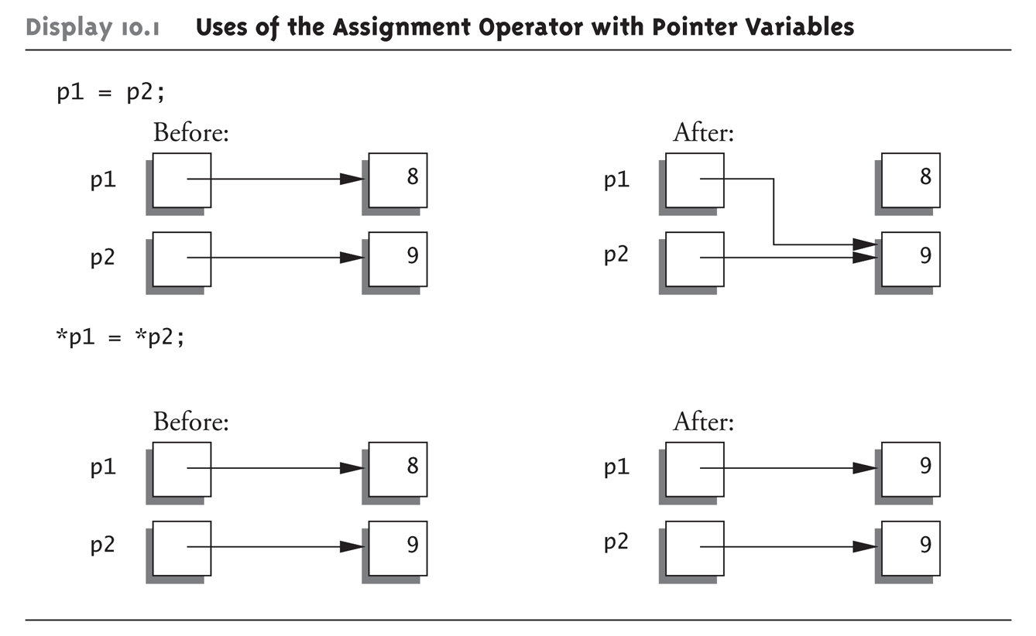
Pointer Assignments
int *p1, *p2;
p1 = p2; //Assigns one pointer to another.
*p1 = *p2; //Assigns “value pointed to” by p1. to “value pointed to” by p2.
Notes:
宣告兩個整數型態的指標變數p1和p2
此時我們要將兩個指標變數指向同一位置的指定運算(=)有兩種情況
一開始p1和p2都是分別指向不同位置，第一種將p1 = p2的做法是指說P1指向P2的位置
第二種*P1 = *P2的情況則是P1指標變數的值更改為P2指標變數的數值

Slide 5
The new Operator
The operator new can be used to create variables that have no identifiers to serve as their names.
int *p1;
p1 = new int;
*p1 = 42; //p1 = new int(42)
Variables that are created using the new operator are called dynamic variables, because they are created and destroyed while the program is running.

Slide 6
The delete Operator
The delete operator eliminates a dynamic variable and returns the memory that the dynamic variables occupied to the freestore.
int *p1;
p1 = new int;
*p1 = 42;
delete p1;
Notes:
P1在delete之後還在，因為只是原本指到的variable被刪除掉，也就是原本用\new int建出來的空間被釋放了

Slide 7
Dynamic Array
In fact, array variables are actually pointer variables
int arr[10] = {0,1,2,3,4,5,6,7,8,9};
int *ptr = arr;
for(int i=0;i<10;i++)
cout << ptr[i];
delete [] ptr; //arr will loss
int *ptr = new int [10];
for(int i=0;i<10;i++)
ptr[i] = i;
for(int i=0;i<10;i++)
cout << ptr[i];
delete [] ptr; //delete ptr [] ILLEGAL
Notes:
動態配置記憶體是指當程式在執行過程時，才提出配置記憶體的要求，主要的目的是讓記憶體運用更加的彈性。
我們可以分別使用new和delete來配置或是釋放記憶體空間，資料型態範圍除了一般C++的基本型態外還可以使用structure來自訂資料型態
首先在配置的宣告會是資料型態的指標變數 = new運算子 資料型態()中為初始值
右方舉例 動態配置int資料型態，*ptr為45，且更詳細一點的操作就會像是右方的步驟
若是不想是先指定初始值的話 ()是可以省略的
那如果是要進行Dynamic array的話就是使用中括號來表示，裡面的數字就是要分配多少元素個數給他
那最後要將分配的記憶體使放就是使用delete 後方在加上你所宣告的指標
是放完記憶體之後建議可以將ptr指標去指向NULL，使用這個是因為可能你程式碼寫到最後忘記這個已經被釋放掉了，可能你後續使用到就會出錯!

Slide 8
Multidimensional Dynamic Array
typedef int* IntArrayPtr; // IntArrayPtr == int*
IntArrayPtr *mat = new IntArrayPtr[5]; // =>int* *mat = new int*[5]
for(int i=0;i<5;i++)
mat[i] = new int [5];
IntArrayPtr[5]
int[5]
int[5]
mat
int[5]
int[5]
int[5]

Slide 9
Learning Objectives
Class, Pointers
The this pointer
Destructors, copy constructors
Separate Compilation
Encapsulation reviewed
Header and implementation files
Namespaces
Using directives
Creating a Namespace

Slide 10
The this Pointer
Member function definitions might need to refer to calling object
The this pointer points to the calling object.
class test{
func(int a){
this -> a = a;
}
public:
int a;
}
The arrow operator(->):
combines the actions of a dereferencing operator(*) and a dot operator(.)
this -> a == (*this).a
Notes:
基本上compiler會自動對class內的member variable前面加上this->，表示其是當前呼叫的class底下的變數

Slide 11
Shallow and Deep Copies
Shallow copy
Assignment copies only member variable contents over
Default assignment and copy constructors
Deep copy
Pointers, dynamic memory involved
Must dereference pointer variables to “get to” data for copying
Write your own assignment overload and copy constructor in this case

Slide 12
Copy Constructors
Automatically called when :
Class object declared and initialized to other object
When function returns class type object
When argument of class type is “plugged in” as actual argument to call-by-value parameter
Requires “temporary copy” of object
Copy constructor creates it
Default copy constructor
Like default “ = ”, performs member-wise copy
Pointers → write own copy constructors !
class test{
test(const test& obj);
…
};
test t1;
test t2(t1); //copy members from t1 to t2

Slide 13
Destructor Need
Dynamically-allocated variables
Do not go away until “deleted”
If pointers are only private member data
They dynamically allocate “real” data
In constructor
Must have means to “deallocate” when object is destroyed
Answer : destructor!

Slide 14
Destructors
Opposite of constructor
Automatically called when object is out-of-scope
Default version only removes ordinary variables, not dynamic variables
Defined like constructor, just add ~
MyClass :: ~MyClass(){
// perform delete clean-up duties
}

